Slide 1
Project Presentation of Co-Op Project at Industry (Module-2)
On
A Review of Artificial Intelligence Integration in Modern Software Development Practices
Name: Akshat Khosla, Aman Sharma, Aditya Aggarwal, Aditya Chauhan
Roll Number.: 2210991226, 2210991248,2210991184,2210991190
Supervised By
<Dr. Shikha Tuteja>
Department of Computer Science and Engineering,
Chitkara University, Punjab

Slide 2
Table of Content
Introduction
Problem Statement
Methodology
Tools and Technologies
Findings and Outcomes
Code Snippets
Conclusion and Future Scope
References/Links used

Slide 3
Introduction
Advancements in Artificial Intelligence (AI) have significantly transformed modern software development practices. Unlike traditional development, AI-powered tools such as GitHub Copilot and Amazon Q Developer actively assist developers in coding, testing, debugging, and improving productivity throughout the software development lifecycle.
However, this transformation also introduces challenges such as security risks, lack of transparency, and overdependence on AI-generated code. This research explores both the benefits and challenges of AI integration in software development using a data-driven approach.

Slide 4
Problem Statement
Traditional software development relies on manual coding, testing, and debugging processes. However, with the rise of AI-powered development tools, developers increasingly depend on intelligent systems for code generation and automation. This shift introduces new challenges such as security risks, lack of transparency, and overdependence on AI-generated solutions.
When AI-powered development tools generate incorrect code, behave inconsistently, or produce unclear solutions, developers experience confusion and reliability concerns. Unlike traditional development methods, AI systems often do not fully explain their logic, making it difficult for developers to understand the generated output. This lack of transparency can lead to security risks, reduced trust, and overdependence on AI-generated solutions.
AI-powered development tools offer efficiency and automation in software development. However, limited research focuses on challenges such as security risks, transparency issues, and dependency on AI-generated code. Therefore, this study analyzes the impact of AI integration on coding, testing, debugging, and overall developer productivity using a data-driven approach.

Slide 5
Methodology
The research adopts a data-driven methodology to analyze the integration of Artificial Intelligence in modern software development practices. The study focuses on how AI-powered tools assist developers in coding, testing, debugging, and improving overall productivity. A comparative research approach was used, where different AI development tools and real-world software development practices were analyzed to evaluate their efficiency, accuracy, and impact on software development processes.
For data collection, information was gathered from research papers, industry reports, and real-world case studies related to AI-powered software development tools. The study analyzed coding efficiency, testing speed, debugging performance, and developer productivity to understand the overall impact of AI integration in modern software development practices.

Slide 6
Tools and Technologies
Research Setting: AI-powered software development environment
Participants: Developers using AI-based coding tools
Interaction Medium: GitHub Copilot, Amazon Q Developer, Tabnine
Data Collected: Research papers, industry reports, and case studies
Approach Used: Comparative and data-driven analysis
Analysis Method: Evaluation of coding efficiency, testing, debugging, and productivity improvements

Slide 7
Finding and Outcomes
The findings of this study show that Artificial Intelligence has significantly improved modern software development practices. AI-powered tools help developers increase coding speed, improve testing, reduce debugging time, and enhance overall productivity.
The analysis shows that developers increasingly depend on AI-powered tools for coding, testing, and debugging tasks. While these tools improve efficiency and productivity, excessive dependence on AI-generated solutions may reduce problem-solving skills and create reliability concerns in software development.
In addition, the study reveals that increasing reliance on AI tools is changing modern software development practices. While AI improves coding efficiency and productivity, challenges such as security risks, lack of transparency, and overdependence on AI-generated code still remain. Overall, the findings confirm that AI has become an important part of modern software development, but it should assist developers rather than replace them completely.

Slide 8
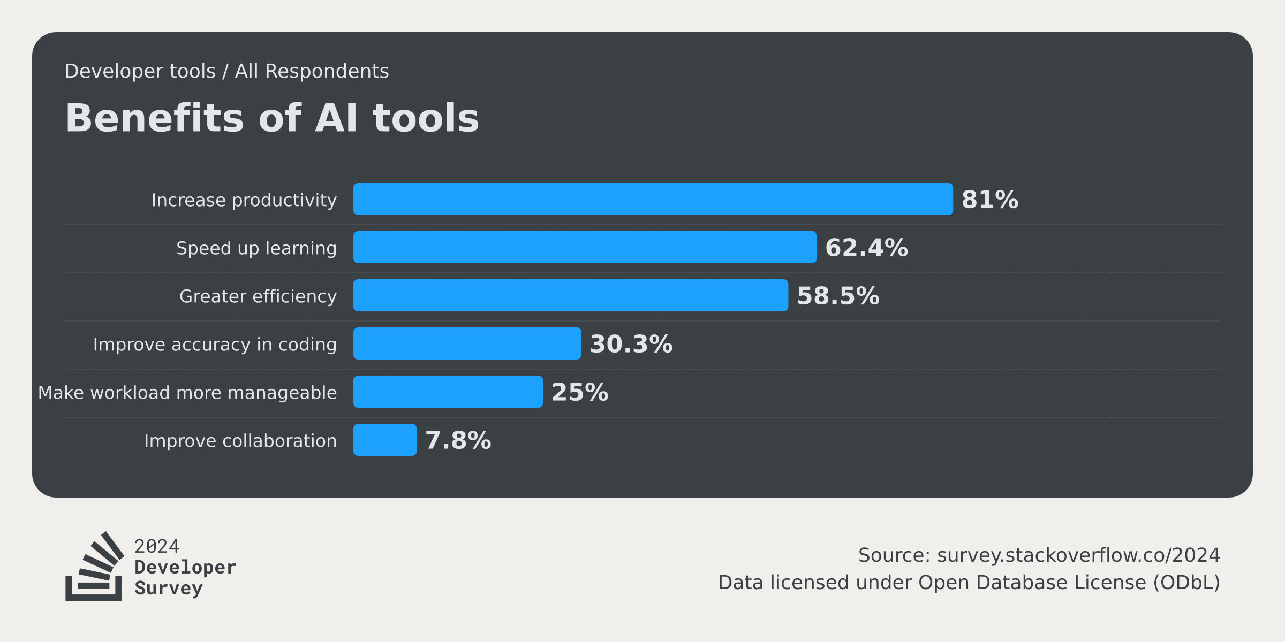
Finding and Outcomes

Slide 9
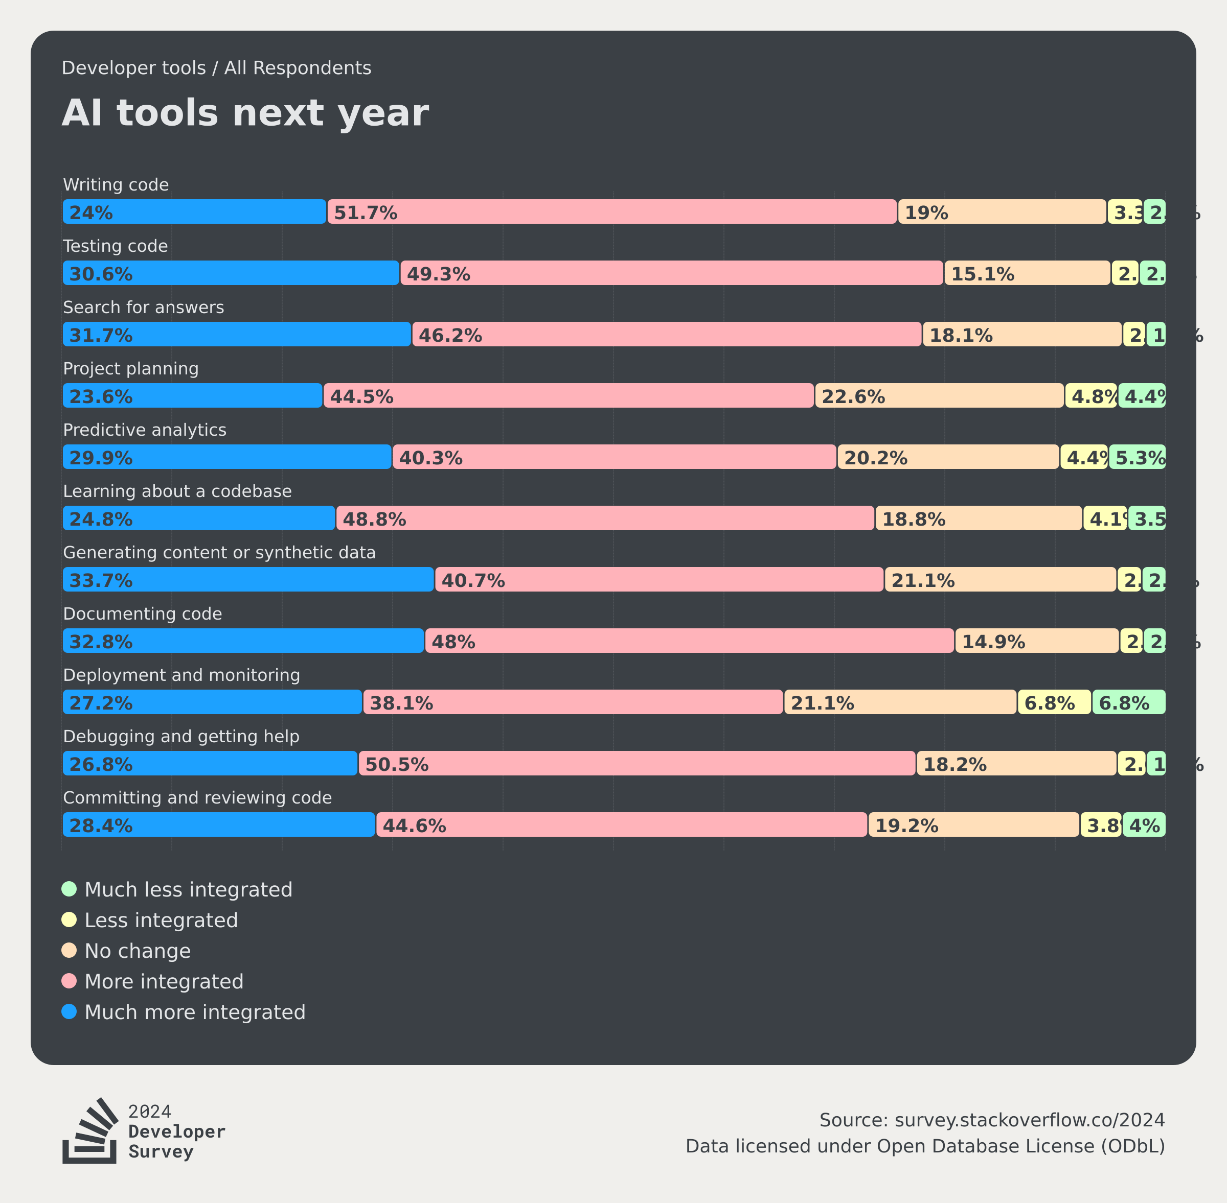
Finding and Outcomes

Slide 10
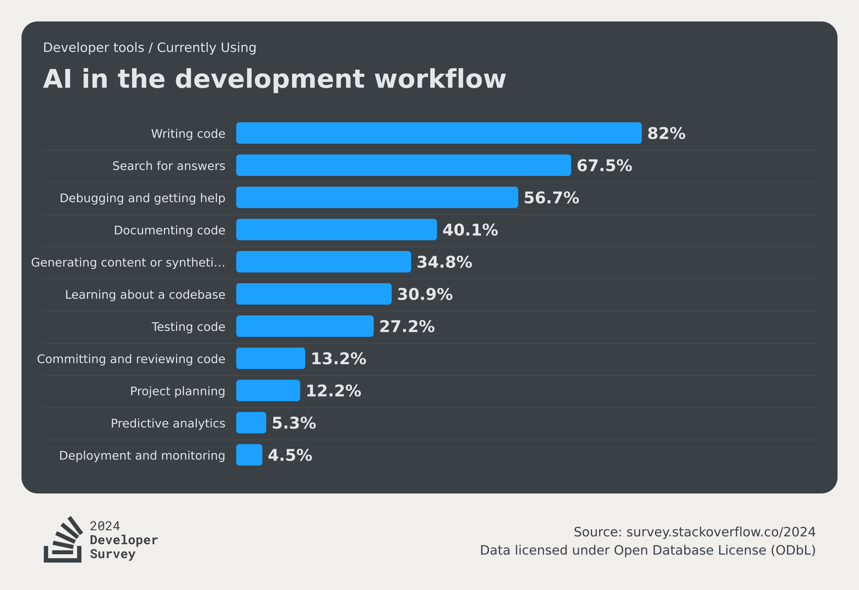
Finding and Outcomes

Slide 11
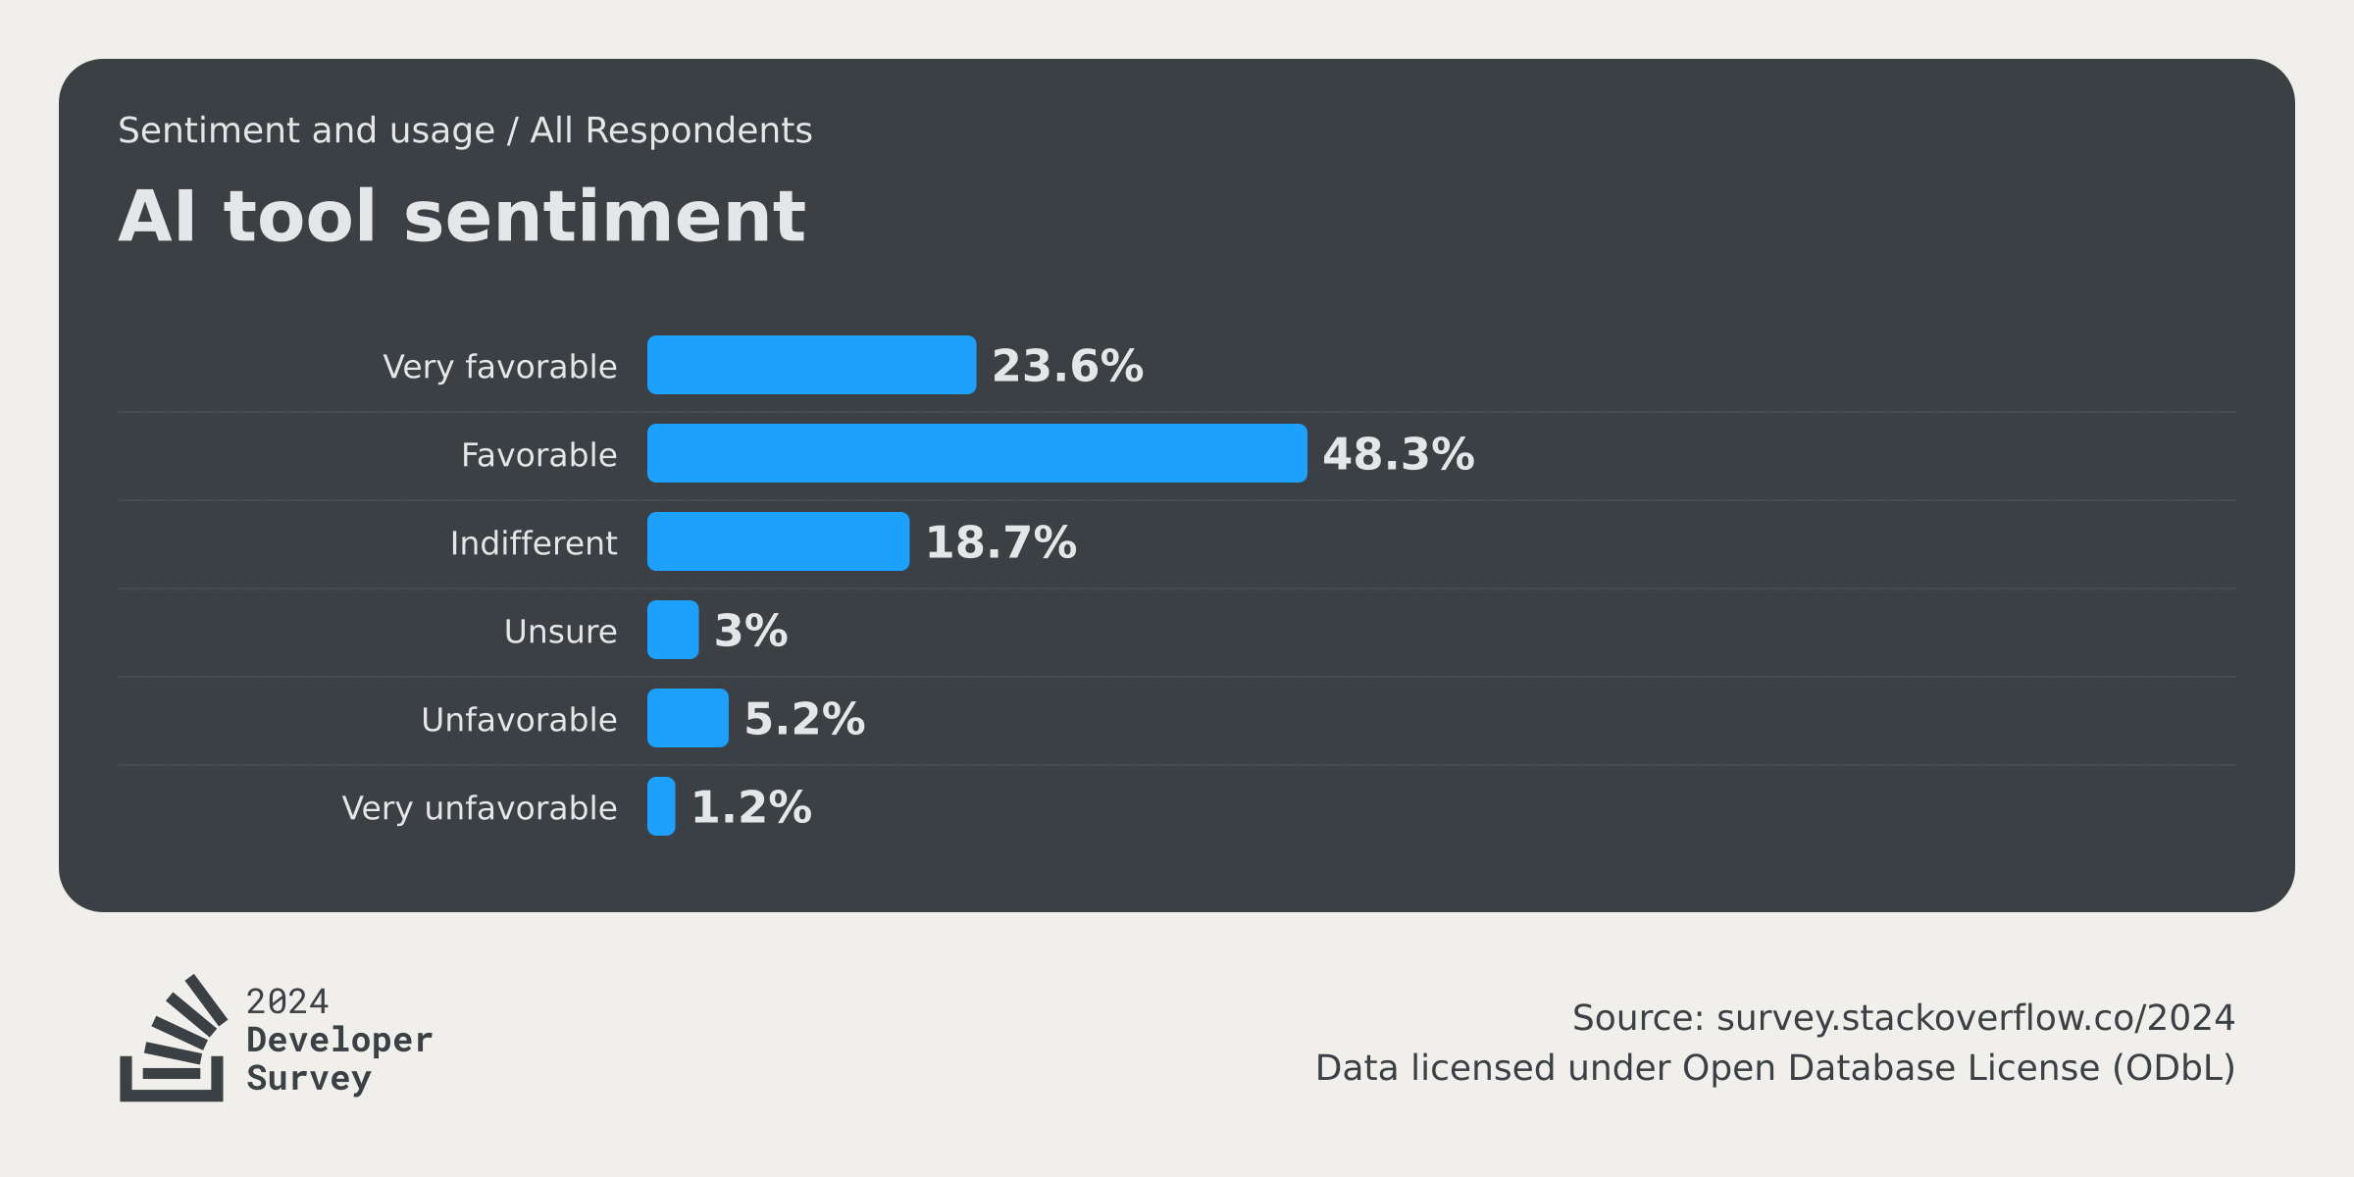
Finding and Outcomes

Slide 12
Conclusion and Future Scope
In the future, this study can be extended by exploring more advanced AI technologies and their impact on software development practices. Using larger industry datasets and real-world development environments can provide deeper insights into how AI-powered tools improve coding, testing, debugging, and overall developer productivity.
Further research can also focus on improving AI-powered development tools by making them more transparent, reliable, and secure. AI systems should provide clear explanations for generated code and decisions to help developers better understand and trust AI-assisted software development processes.
Additionally, studying long-term AI integration can help understand how developers depend on AI-powered tools over time and how it affects software development practices. Future work can also explore how balanced and efficient use of AI can improve productivity while maintaining strong problem-solving and development skills.
Overall, the study highlights that AI systems should not only focus on automation and efficiency but also on transparency, reliability, and security. Designing AI-powered development tools that support trust and effective human-AI collaboration is essential for improving modern software development practices.

Slide 13
References
Grand View Research – Artificial Intelligence in Software Development Market Report
GitHub – GitHub Copilot Documentation
Amazon Web Services – Amazon Q Developer Documentation
Stack Overflow – Developer Survey on AI Tools Adoption
Anthropic – Claude AI Research and Enterprise Usage Report
Brown, T. B. et al. – Language Models are Few-Shot Learners
Kim, M., Lee, S., Park, J. – Automated Test Case Generation Using Machine Learning Techniques
Pedregosa, F. et al. – Scikit-learn: Machine Learning in Python
Yin, S. et al. – AI-mediated Social Support and Human-AI Collaboration

